Slide 1
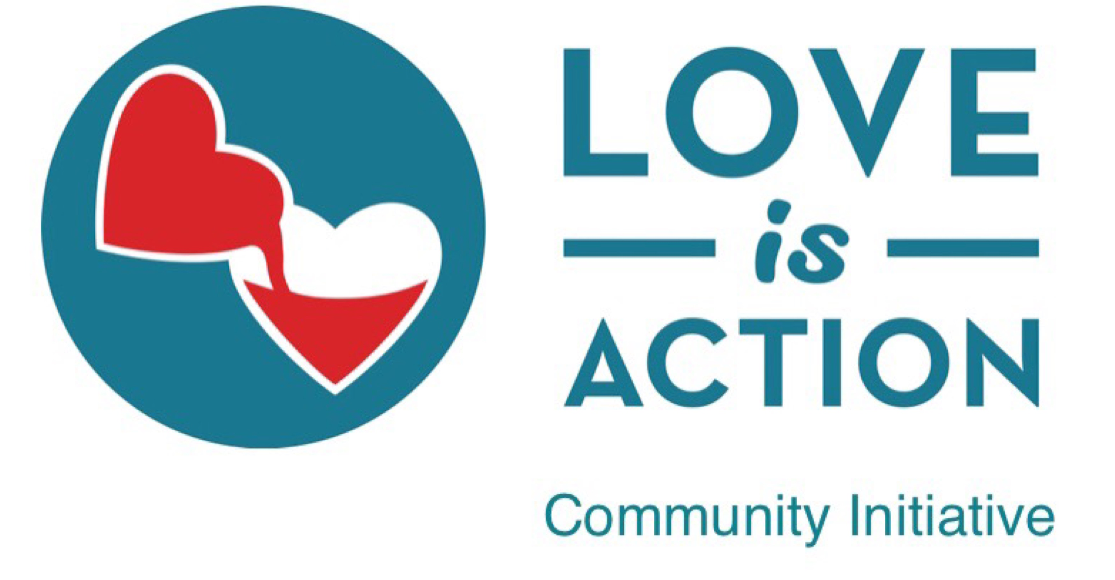
is an collective impact platform between community stakeholders that is led by public and private child welfare and churches, which offer vetted programs and resources that facilitate safe methods of engagement between people who care and people who need care
www.loveisaction.com

Slide 2
Love Is Action is an initiative of Successful Survivors Foundation, an educational 501 c 3 organization
www.loveisaction.com

Slide 3
Successful Survivors Foundation and Speaker Bureau is a coalition of experts engaged in empowering organizations that serve the vulnerable
www.loveisaction.com

Slide 4
The Love Is Action Community Initiative identifies and vets safe, effective programs, promising practices, and resource partners that can be replicated or expanded into communities throughout the US
www.loveisaction.com

Slide 5
LOVE IS ACTION COMMUNITY INITIATIVE
acts as an intermediary
1. We Find partners that provide services to a vulnerable population while operating at or above our specific risk management guidelines.
2. We hope to help Fund these partners so that they can replicate in other communities that need the programs/services they have mastered.
3. We help to Form partners with resources, training, networking, and assistance from our coalition of vetted experts.
4. We Feature our partners through outcomes data tracking and reporting to provide visibility, assure sustainability of their programs and services, to recognize and celebrate the good they are doing, and to help others replicate these good programs where the needs are great.
www.loveisaction.com

Slide 6
Which child welfare organizations, ministries, promising practices, and resources are considered for partnership?
www.loveisaction.com

Slide 7
Twenty-five years of data around tragedy in child welfare positions us to identify safe, effective partners to serve as leaders in their communities
www.loveisaction.com

Slide 8
We look for Christian child welfare programs because our data suggests that children in served in Christ-centered programs are safer and enjoy better outcomes
www.loveisaction.com
www.loveisaction.com

Slide 9
WHY?
www.loveisaction.com

Slide 10
Christ-centered child welfare organizations are relationship-based.
Staff and foster parent turnover rates are lower than in the average child welfare organization. The average length of stay for children in care is longer than the national average. Consequently, there are fewer breaks in relationship, which is the #1 cause of tragedy in child welfare
www.loveisaction.com

Slide 11
Love Is Action is a platform which gives community stakeholders opportunities for engagement in ways that are in addition to the typical options of monetary donations, fostering, and adopting
www.loveisaction.com

Slide 12
Neighbors can
“adopt a social worker”
“adopt a foster family”
provide respite care
provide goods and services like hair cuts, car maintenance, provide transportation, and so much more.
www.loveisaction.com

Slide 13
With the support of national corporate sponsors, we can encourage involvement from people who have never connected with your organization
www.loveisaction.com

Slide 14
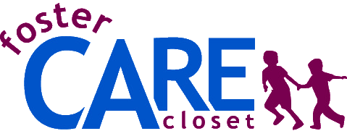
Some of the vetted, proven programs that are ready to partner with you
Prevention | Supportive Intervention | Mitigation | Resources
Click on the links to imagine some of the collaborations that are possible
www.loveisaction.com

Slide 15
A Love Is Action resource partner is the National Foster Parent Association and the National Foster Parent Association Training Institute, NFPAti.org.
All training is free of charge, 24/7, to any parent (birth, step, foster, adoptive, kinship, etc) and to anyone who works with families.
Trainings include:
Trauma Informed Care
Conflict De-Escalation
Preventing Tragedy In Foster Care
much more
www.loveisaction.com

Slide 16
Love Is Action partner Safe Families For Children, through a partnership between private child welfare and the local church, works with fragile families to prevent unnecessary removal and to secure permanency for children.
Partnership with public and private child Welfare is critical for those times when foster care, or other services, is necessary.
www.loveisaction.com

Slide 17
Love Is Action partner Teen Leadership Foundation, through a partnership between public and private child welfare and the local church, gives transition-aged youth a supervised apartment, a job, job skills and leadership training, and church families to mentor and guide successfully into adulthood. Part of the program is a social enterprise business that trains teens in an applicable job skill.
www.loveisaction.com

Slide 18
Love Is Action partner Royal Family Kids, through a partnership between public and private child welfare and the local church, takes foster kids aged 6-12 to camp in the summer to create relationships that are carried on monthly at Royal Family Club meetings at the local church. This gives the foster families a one-week break in the summer plus 3 hours per month.
www.loveisaction.com

Slide 19
Love Is Action partner Your Real Success is a curriculum for TAY that is delivered virtually in partnership with public or private child welfare organizations and volunteers from churches. This collaboration encourages mentoring while mining the lessons out of adversity, thereby preparing transition-aged youth to create self-sufficient, successful lives that are rooted in faith and their church family.
www.loveisaction.com

Slide 20
Love Is Action partner The Foster Haven is a collaboration between public child welfare and volunteers from churches who help to ease children into foster care during the scariest times of their lives by establishing private, volunteer staffed foster care intake centers.
www.loveisaction.com

Slide 21
Love Is Action partner The Foster Care Closet is a collaboration between public child welfare, churches, and retailers who give dignity to children entering foster care by providing them new clothing, shoes, and school supplies
www.loveisaction.com

Slide 22
Other Love Is Action partners include
Association for Christian Childcare Administrators,
National Foster Parent Association,
GAMECHANGER Healthy Choice Initiative, Handle With Care, Obria Medical Clinics, and more
www.loveisaction.com

Slide 23
Thank you for this opportunity to explain how the Love Is Action Community Initiative can help your organization fulfill your mission of sharing the healing love of Christ with children and families
WE ARE HERE TO HELP YOU
For additional information, please contact Rhonda Sciortino, Chair of Successful Survivors Foundation and National Champion of the Love Is Action Community Initiative, rhonda@successfulsurvivors.org 949.689.5611
www.loveisaction.com

